Slide 1
TUNED AMPLIFIER
Introduction
Band Pass Amplifiers
Series & Parallel Resonant Circuits & their Bandwidth
Analysis of Single Tuned Amplifiers
Analysis of Double Tuned Amplifiers
Primary & Secondary Tuned Amplifiers with BJT & FET
Merits and de-merits of Tuned Amplifiers

Slide 2
DEFINITION:-
An amplifier circuit in which the load circuit is a tank circuit such that it can be tuned to pass or amplify selection of a desired frequency or a narrow band of frequencies, is known as Tuned Circuit Amplifier.

Slide 3
CHARACTERISTICS OF TUNED AMPLIFIER
Tuned amplifier selects and amplifies a single frequency from a mixture of frequencies in any frequency range.
A Tuned amplifier employs a tuned circuit.
It uses the phenomena of resonance, the tank circuit which is capable of selecting a particular or relative narrow band of frequencies.
The centre of this frequency band is the resonant frequency of the tuned circuit .
Both types consist of an inductance L and capacitance C with two element connected in series and parallel.

Slide 4
RESONANCE CIRCUITS:
When at particular frequency the inductive reactance became equal to capacitive reactance and the circuit then behaves as purely resistive circuit. This phenomenon is called the resonance and the corresponding frequency is called the resonant frequency.
C
L
Tu ned c ircuit

Slide 5
Resonance circuits
Series
Parallel

Slide 6
CLASSIFICATION OF TUNED AMPLIFIER
Tuned amplifier
Small Signal Amplifier
Large signal Amplifier
Single Tuned Amplifier
Double Tuned Amplifier
Stagger Tuned Amplifier

Slide 7
CLASSIFICATION OF TUNED AMPLIFIERS
Small Signal Tuned Amplifiers :- They are used to amplify
the RF signals of small magnitude.
They are further classified as:
Single Tuned Amplifiers:- In this we use one parallel tuned circuit in each stage.
Double Tuned Amplifiers:- In this we use two mutually coupled tuned circuits for every stage both of tuned circuits are tuned at same freq.
Stagger Tuned Amplifiers:- It is a multistage amplifier which has one parallel tuned circuit for every stage but tuned frequency for all stages are slightly different from each other.

Slide 8
(2) Large signal tuned amplifiers:-
They are meant for amplifying large signals in which large RF power is involved & distortion level is also higher. But tuned circuit itself eliminates most of the harmonic distortion.

Slide 9
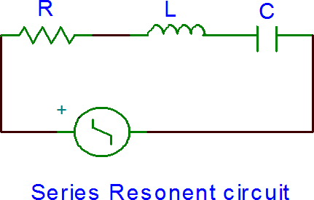
SERIES RESONANT CIRCUIT
It is the circuit in which all the resistive and reactive components are in series.

Slide 10
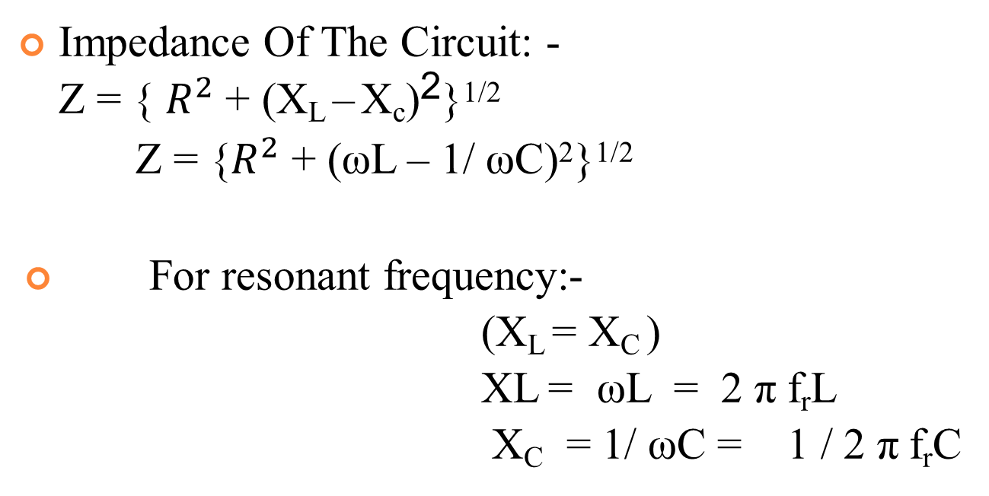
SERIES RESONANT CIRCUIT
Impedance Of The Circuit: - Z = { $R^{2}$ + (X_{L} – X_{c})²}^{1/2}
Z = {$R^{2}$ + (ωL – 1/ ωC)²}^{1/2}
For resonant frequency:-
(X_{L} = X_{C} )
XL = ωL = 2 π f_{r}L
X_{C} = 1/ ωC = 1 / 2 π f_{r}C

Slide 11
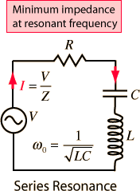
SERIES RESONANT CIRCUIT
Since at resonance,
X_{L} = X_{c}
2 π f_{r}L = 1 / 2Пf_{r}C
f_{r} = 1 / 2 π √LC ω_{r} = 1 / √LC

Slide 12
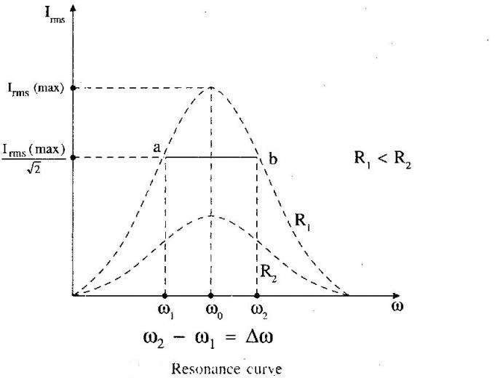
RESONANCE CURVE OF SERIES RESONANT CIRCUIT :

Slide 13
QUALITY FACTOR
It is voltage magnification that circuit produces at resonance is called the Q factor.
Voltage Magnification =
=
^{I}max ^{X}L
/ I_{min} R
X_{L}/ R
At Resonance
X_{L}/R = X_{C}/R
ω_{r}L / R = 1 / ω_{r}RC

Slide 14
IMPORTANT POINTS
Net reactance , X = 0.
Impedance Z = R .
Current is so large & will produce large voltage across inductance & capacitance will be equal in magnitude but opposite in phase.
Series resonance is called an acceptor circuit because such a circuit accepts current at one particular frequency but rejects current at other frequencies these circuit are used in Radio – receivers .

Slide 15
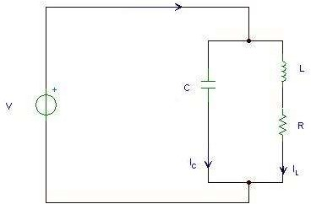
PARALLEL OR CURRENT RESONANCE

Slide 16
PARALLEL OR CURRENT RESONANCE
When an inductive reactance and a capacitance are connected in parallel as shown in figure condition may reach under which current resonance (also known as parallel or anti- resonance ) will take palace. In practice, some resistance R is always present with the inductor.
Such circuit is said to be in electrical resonance when reactive(watt less) components of line current becomes zero. The frequency at which this happened is known as resonant frequency.
Current will be in resonance if reactive component of R- L branch I_{R-L} sinФ R-L = Reactive component of capacitive branch, neglecting leakage reactance of capacitor C

Slide 17
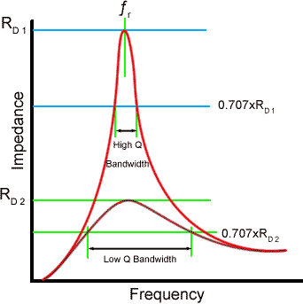
FREQUENCY V/S IMPEDANCE CURVE FOR LCR CIRCUIT

Slide 18

(1) SINGLE TUNED AMPLIFIER
Vc c
C
L
Cin
R1
Cc
RL
+
R2
Vs
Re
Ce

Slide 19
(1) SINGLE TUNED AMPLIFIER
O/P of this amplifier may be taken either with the help of Capacitive.
A parallel tuned circuits is connected in the collector circuit.
Tuned voltage amplifier are usually employed in RF
stage of wireless communication circuits are assigned the work of
, where such selecting the
desired carrier frequency and of amplifying the permitted pass-band around the selected carrier frequency.

Slide 20
SINGLE TUNED AMPLIFIER
Tuned amplifier are required to be
R₁, R₂, & R_{e}
C_{e}
= For biasing & stabilization circuit.
= By pass capacitor
Tuned circuit connected in collector, the impedance of which depend
upon frequency, act as a collector load.
L-C =
If i/p signal has same frequency as resonant frequency of L-C circuit . Large amplification will be obtain because of high impedance of L-C ckt.

Slide 21
CIRCUIT OPERATION
THE HIGH FREQUENCY SIGNAL TO BE APPLIED BETWEEN BASE & EMITTER. THE RESONANT FREQUENCY OF CIRCUIT IS MADE EQUAL TO FREQUENCY OF I/P SIGNAL BY VARYING L OR C .
NOW TUNED CKT WILL OFFER VERY HIGH IMPEDANCE TO THE SIGNAL FREQ. & THUS LARGE O/P APPEAR ACROSS IT.
BANDWIDTH = (F₂- F₁ )
THE AMPLIFIER WILL AMPLIFY ANY FREQ. WELL WITHIN THIS RANGE.

Slide 22
LIMITATION
This tuned amplifier are required to be highly selective. But high selectivity required a tuned circuit with a high Q- factor .
A high Q- factor circuit will give a high A_{v} but at the same time , it will give much reduced bandwidth because bandwidth is inversely proportional to the Q- factor .
It means that tuned amplifier with reduce bandwidth may not be able to amplify equally the complete band of signals & result is poor reproduction . This is called potential instability in tuned amplifier.
Smaller Gain-Bandwidth Product
Does not provide flatten response

Slide 23
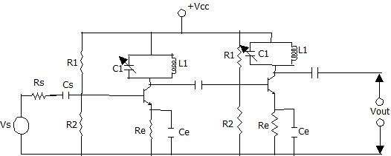
STAGGER TUNED AMPLIFIERS :

Slide 24
STAGGER TUNED AMPLIFIERS
It is a multistage amplifier which has one parallel resonant circuit for every stage, while resonant frequency of every stage
is slightly different from previous stages.
From circuit diagram it is clear that first stage of this amplifiers has a resonant circuit formed by L₁ & C₁ that
f₁ = 1 / (2Π √L₁ C₁)
The o/p of stage is applied to second stage which is tuned to slightly higher frequency.
f₂ = 1 / (2Π √L₂ C₂)

Slide 25
Second stage amplifiers the signals of frequency f₂ by maximum amplitude while other frequency signal are amplified by less quantity . Thus frequency response
Curve of second stage has a peak of f₂ which is slightly higher than f₁.

Slide 26
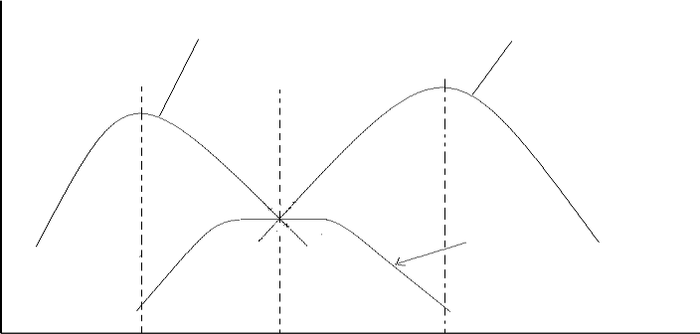
STAGGER TUNED AMPLIFIER
Freq. response of first stage
Freq. response of second stage
Voltage
Over all response
f₁
f₀
Frequency
f₂

Slide 27
STAGGER TUNED AMPLIFIERS
Over all response of these two stage is obtained by combining individual response & it exhibits a maximum flatness around the center frequency f₀ . Thus overall bandwidth is better than individual stage.
Since two stages are in parallel (shunt) & overall bandwidth is increased thus, it behaves like shunt circuits for the increased bandwidth.

Slide 28
COMPARISON BETWEEN TUNED AND AF AMPLIFIER
Tuned Amplifier AF Amplifier
It has to amplify narrow band of frequencies defined by the tuned load at the collector
They are bulky and costlier
Used in radio transmitters and receivers, and television receivers circuits .
Works with a complete audio frequency range
More compact
Amplifies sound signals and act as drive for loud speakers

Slide 29
APPLICATIONS OF TUNED AMPLIFIER
Tuned amplifiers serve the best for two purposes:
a)Selection of desired frequency. b)Amplifying the signal to a desired level.
USED IN:
Communication transmitters and receivers.
In filter design :--Band Pass, low pass, High pass and band reject filter design.

Slide 30
ADVANTAGES
It provides high selectivity.
It has small collector voltage.
Power loss is also less.
Signal to noise ratio of O/P is good.
They are well suited for radio transmitters and receivers .

Slide 31
DISADVANTAGES
They are not suitable to amplify audio frequencies.
If the band of frequency is increase then design becomes complex.
Since they use inductors and capacitors as tuning elements, the circuit is bulky and costly.

